Slide 1
CYBER THREAT HUNTING
PRESENTED BY: JOSHUA ASIACHI MURUNGA
REG. NO.: SP13/21799/14

Slide 2
INTRODUCTION
Infection vectors change rapidly and continuously. Cyber criminals are constantly evolving and their tactics and techniques are increasingly changing with an alerting rate.
Expecting security controls to block every infection vector is unrealistic.
Security experts around the globe have acknowledged that organizations can get infected no matter how good their security controls are.

Slide 3
INTRODUCTION cont’d
Cybercriminals pose a real and persistent threat to businesses, governments and financial institutions all around the world.
The attackers use new delivery methods from social engineering to zero day exploits.
Social Engineering is the use of influence and persuasion to deceive people for the purpose of obtaining information or persuading the victim to perform some action.
Zero day exploits are attacks that tries to exploit computer application vulnerabilities which are unknown to others or the software vendor and no security fix is available.

Slide 4
INTRODUCTION cont’d
Malicious programs have always been an important tool in cyber criminals portfolios and almost everyday we are detecting new variants of malware programs such as Ransomware.
Ransomware is a type of malware that removes a user access to their data and request for a ransom payment to re-instantiate data access.
Ransomwares utilize different infection vectors ranging from social engineering and spam emails to botnets for distribution.

Slide 5
INTRODUCTION cont’d
Such threats go unnoticed when attackers break through the primary security tools such as firewalls, anti-spam, sandboxing, intrusion prevention systems, that only create a perimeter around the system and does not account for what happens when attackers slip through the defense.
To prevent such cases from constantly occurring, we delve into threat hunting, a post infection measure from the cyber kill chain.

Slide 6
What is Cyber Threat Hunting?
Proactively searching the network for threats that have evaded the existing security measures.
The act of aggressively intercepting, tracking and eliminating cyber adversaries as early as possible in the cyber kill chain.
The earlier a threat is detected within the chain, faster response and recovery of operations and services can be achieved. Threat hunting is categorized under the active defense category, and is considered one of the most effective components of intelligence.

Slide 7
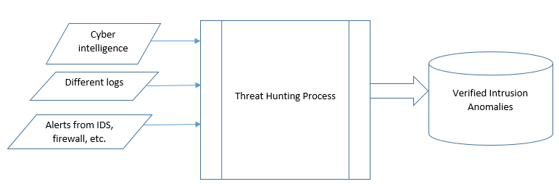
Threat Hunting Process

Slide 8
Threat Hunting Process cont’d..
The threat hunting process as a whole, as shown in the diagram above, requires inputs in the form of:
cyber intelligence, which requires an expertise in cyber security,
different system logs and
alerts from IDS, Firewalls and other security tools, for the purpose of scrutinizing, that requires an expertise in analytical skills
The threat hunting process itself is divided into three stages.

Slide 9
Stage 1: Planning
Here, the assets of importance are identified, meaning, the most important, say information in the data centers held by enterprises, are identified and close security measures are deployed in these areas.
Different security teams deployed by the organizations are responsible for the different threat hunting tasks, looking out for the enormous variety of attacks and intrusions that may threaten the integrity of the system.
One team could be performing host hunting, another network hunting and others could be performing the threat intelligence analysis.
The collective work of each team, under a supervisory role that serves as the primary command and control node responsible for planning and execution of the threat hunting operations, make up the threat hunting process a success.
Notes:
Host Hunters examine information systems and endpoints for indicators of compromise.
Network Hunters are the network based counterpart to Host Hunters. Network Hunters focus on examining network activity via network flow, packet analysis, and network device logs.
The Threat Intelligence Analyst will consume and generate threat intelligence that drives hunt operations.

Slide 10
Stage 2: pursuing and detection
Threats are pursued using two approaches:
inspecting known threats whereby it relies much on the Indicators of Compromise (IoC) such as known signature attacks.
detecting unknown threats by setting the baseline of what is considered normal activities, thereby enabling the ability to detect deviations and, with high possibility, unknown threats.

Slide 11
Stage 3: responding
This is the active stage of threat hunting process and that includes using the needed and efficient means to detect and stop the attack at the earliest stage possible
This stage heavily relies on threat intelligence and threat information
Threat intelligence can be described as the aggregation, transformation, analysis, interpretation and enrichment of threat information to provide the necessary context that can aid decision making.
Threat information is any information that can help an organization to protect itself against a threat or detect the activities of a threat actor

Slide 12
Threat Hunting On The Rise
Threat hunting has been on the rise and requires quiet some amount of technical skills and the right mindset i.e. a shift to a post-infection mentality.
Some of the skills required include threat intelligence, where intelligence reports are gathered from various sources, which will help security teams in incident detection and analysis.
Besides that, a set of threat detection tools have been developed to help in the massive workload of threat hunting.
These tools include:
SIEM (Security Incident and Event Management),
EDR (Endpoint Detection and Response) and
NDR (Network Detection and Response).
Even with these tools, threat hunting is a challenge for a variety of reasons

Slide 13
Challenges
The data to be collected involves installing agents on endpoints and/or hardware placed on networks which can actually be quite expensive even for large enterprises.
The collected data lacks a broader context and historical perspective for security analysts to pinpoint an infection.
Few organizations have the necessary skill set and resources to analyze data and identify persistent threats.
The threat hunting process can miss traffic from mobile devices that don’t have the collection agent installed.
Notes:
Currently threat analysts are not only being poached but they are also being recruited from the ranks of network engineers, database managers, ethical hackers, software developers, and other specialty disciplines that have bearing on the information technology and cybersecurity fields

Slide 14
Rethinking The Approach
To address the shortcomings of the existing approaches, we look into wide area networking along with the sharing in cybersecurity threat intelligence and threat information, and also enabling the sharing of Indicators of Compromise (IoC).
Wide Area Networking (WAN) in this case is basically achieved through cloud computing.
Cloud computing is a model for enabling convenient, on-demand network access to a shared pool of configurable computing resources such as servers, storage, networks, applications and services.

Slide 15
Software-Defined Wide Area Networking (SD-WAN)
Cloud based SD-WAN is a new architecture, whereby all the entities of any typical enterprise network are all connected into a network in the cloud.
These entities include all the enterprise’s branches, the data centers, cloud infrastructure and even mobile device users
All these elements connect to the cloud network backbone through a global series of Points of Presence (PoPs).
This creates a single unified network, that carries all traffic of the various enterprise entities that are connected, including corporate internet plus WAN traffic.

Slide 16
Software-Defined Wide Area Networking (SD-WAN) Cont’d…
Having all this traffic flow on one network forms a valuable dataset for threat hunting.
Cloud providers could use this single, unified source of data flowing across their cloud network as input to a new threat hunting service.
Traditional network security solutions are built at the level of a single branch network. All the traffic they inspect is isolated and limited to a specific location, such as a branch or a geographic location.
Because the cloud service providers have their own network backbone into which they have full visibility, they can see all the network traffic, from all consumers, all over the world.

Slide 17
Software-Defined Wide Area Networking (SD-WAN) Cont’d…
This visibility into so many network flows and so much data, are unique and it allows the cloud service providers to build the models that will enable full threat hunting based on unlimited raw data.
These models evolve three aspects of data context:
client classification,
the target and
communication over time.

Slide 18
Client Classification
when other security solutions inspect the source client with network flow, entities such as source IP, username and device name are considered. This information is usually used to distinguish different devices over the network but it is rarely used in the actual decision making of whether the traffic is malicious or not.
Client classification can then be expanded into a broader scheme using elements such as whether HTTP (Hyper Text Transfer Protocol) or TLS (Transport Layer Security protocol) is part of the main communications, the unique fingerprints of various web browsers and the various types of libraries they use.
These items provide much more detail and by analyzing this data with machine learning, cloud service providers can classify different clients on their networks quite accurately.

Slide 19
The Target
The other context element is the target, i.e. the IP (Internet Protocol) or domain address that a client is connecting to.
The target is commonly part of the network flow that is used in the decision making process of whether something is malicious or not. Most security solutions simply compare the target against a list of security feeds.
This model goes further by creating a popularity score to each target seen in the network.
The score is calculated based on the number of times client communicate with the targets.
Scores of all targets are then collected and typically, the lowest scored target are indicators of malicious or command and control websites

Slide 20
Communication Over Time
Active malware keeps communicating over time, for instance, to exfiltrate data.
The time or repetitiveness is an important data element.
The more the external communication is repeated uniformly, the more likely it is a machine or bot that is generating this traffic and thus more likely to be malicious traffic.

Slide 21
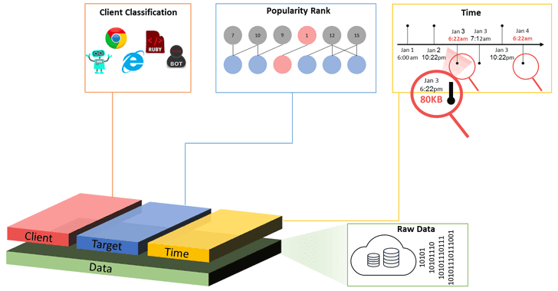
The Three Dimension Context

Slide 22
The Right Cloud Model
Compared to public cloud, the private and community cloud offers enterprises a greater degree of security.
It is in these cloud models that we expect to get the SD-WAN services.
Since not all enterprises can sustain the expense of a private cloud, they may look into a community cloud, where the cloud services are provisioned for use to a specific community of consumers from enterprises that share the same concerns such as security.
With the sharing of Indicators of Compromise (IoC) and cybersecurity threat intelligence across different community clouds and among cloud service providers, threat hunting becomes a timely and successful process.
Responses would even be more intense if an attack has already succeeded or is in progress

Slide 23
Conclusion
For any cyber threat, prevention is ideal but detection is a necessity.
Threat hunting is an effective and critical security measure that is needed to minimize business impact of attacks, improving visibility of enterprises’ environments and weaknesses, and achieve proactive, accurate and early detection of threats.
The threat hunting process requires the continuous monitoring of systems to help keep IoC and thresholds of normal behavior updated and matching the changes in the monitored systems.
This is best achieved through SD-WAN, a cloud computing architecture where all the entities of any typical enterprise network are all connected into a network in the cloud.
This approach of threat hunting is particularly unique since the cloud providers not only monitor the system logs but also the raw network data that carries a lot of information.

Slide 24
References

